Slide 1




UTAR SL Yoga Club 2026/2027
ANNUAL 26/27
PROPOSAL
UTAR SL Yoga Club

Slide 2




UTAR SL Yoga Club
Our team & committee
2025/2026 Overview:
-Activity & Achievement
-Financial Report
PROPOSAL
AGENDA
Nomination & Voting
Election of new committees
Speech by the new committees
Handover Ceremony
Photo Session
Q&A session

Slide 3
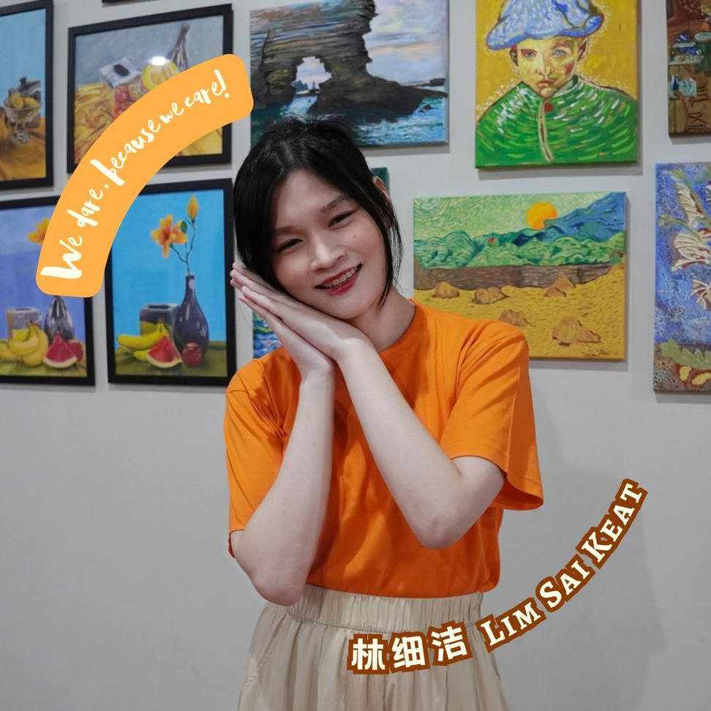


UTAR SL Yoga Club
CHAIRPERSON
SUSIE LIM
IG: susielim.saki
SRC & Chair of Yoga Club
AGENDA 1

Slide 4
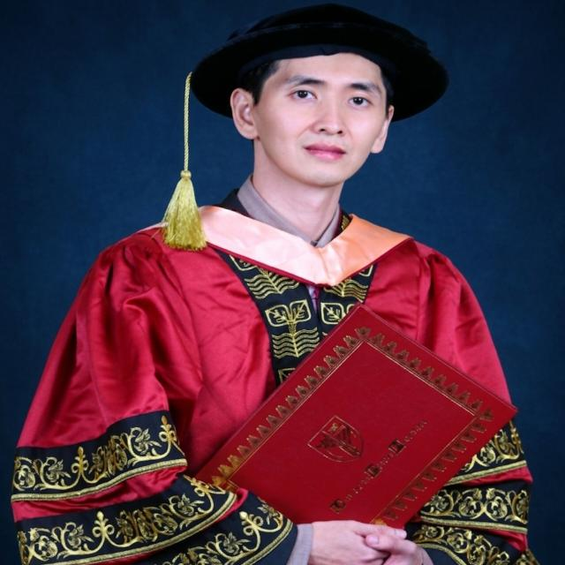
UTAR SL Yoga Club
ADVISOR
DR LEE WAH PENG
AGENDA 1

Slide 5
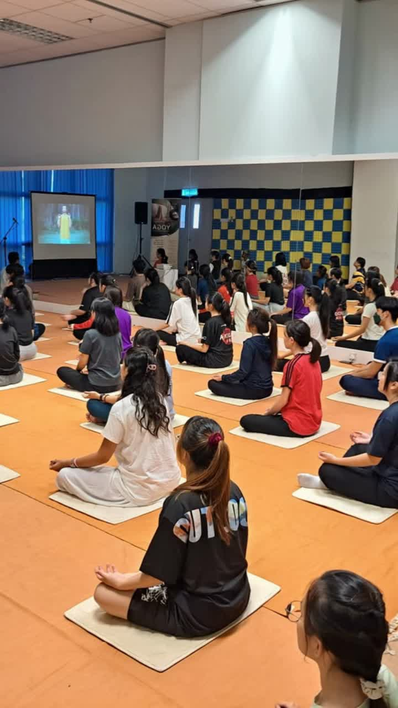

UTAR SL Yoga Club
LAST YEAR RECAP
ACTIVITY AND ACHIEVEMENT
AGENDA 2

Slide 6

UTAR SL Yoga Club
AGENDA 4
25/26 FINANCIAL REPORTING
OUR LAST YEAR ACCOUNT BALANCES IS RM16.5K
Presented by TARVEEN KAUR

Slide 7
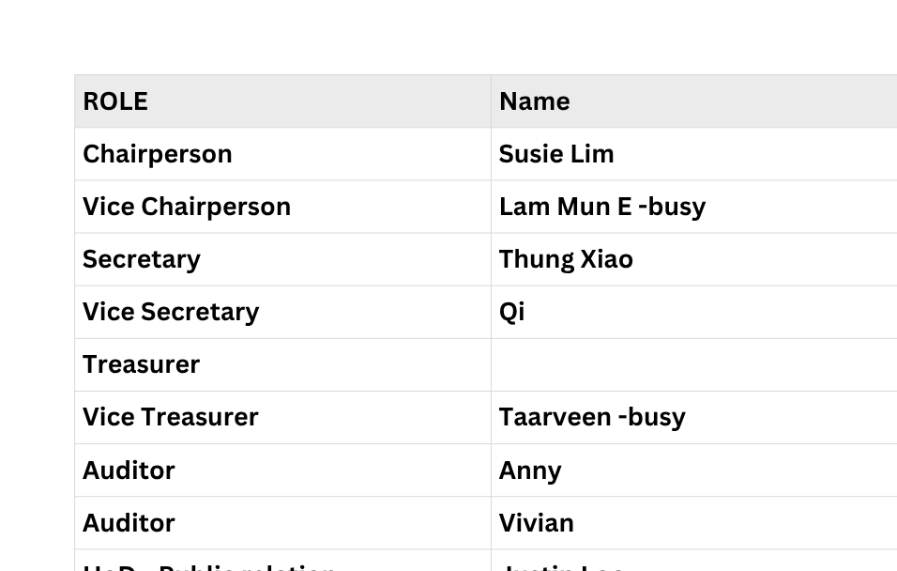
UTAR SL Yoga Club
AGENDA 4

Slide 8

UTAR SL Yoga Club
AGENDA 5 & 6
COMMITTEE ROLE AND RESPONSIBILITIES
Comittee

Slide 9


UTAR SL Yoga Club
HEAD OF DEPARTMENT
COMMITTEE MEMBERS
Expected outcomes
  Publicity: Design peripheral OR Graphic design, Boardcasting, run social media, promote events.
  Public Relations: External Networking, Public Image, Communication, Contract Negotiation
  Event Organization (Productions): Plan events, Directing logistics, Ensure quality, and decide how an event is staffed
  Fundraising & Future Planning: Initiatives new activities & Event, find potential sponsors, Redirect details executions to other dept.
AGENDA 5

Slide 10
UTAR SL Yoga Club
Communication Issues / Long-term Planning
Is Event
(No comms barrier)
Event Organization
生产部
Publicity
宣传部
Have comms Issues
Public Relations
公关部
Fundraising & Future Planning
创意规划部
Event Promotion
Luxury Yoga Experiences Audit
collaboration
Recurring Handling
Publicity 2
Luxury Experiences & Demand finding
奢华体验与需求挖掘
Is Funding
(No comms barrier)
Auditor 审计员 → Audit workflow and document
Treasurer 财政 → Resolve money issues
University Workflow Audit
Secretary 秘书 → Submit / Audit paperworks. (Submit to UTAR)
Club Chair & Vice Chair 主席 → Supervises all the event, funding, reminding / initiative task execution, handover, problem solving.
chair and vice chair must prepare the content early one month

Slide 11

UTAR SL Yoga Club
YOGA WEEKLY CLASS PRICING POLICY
Updates of the pricing policy
upgrade to more consistancy.
Expected outcomes
  Flat rate: No more different for non-member and member pricing. Every one RM10
  Shift member benifit: “Semester Free class” is only exclusive for member only. Member can enjoy member night, free foods, and end sem free gift etc.
AGENDA 5

Slide 12
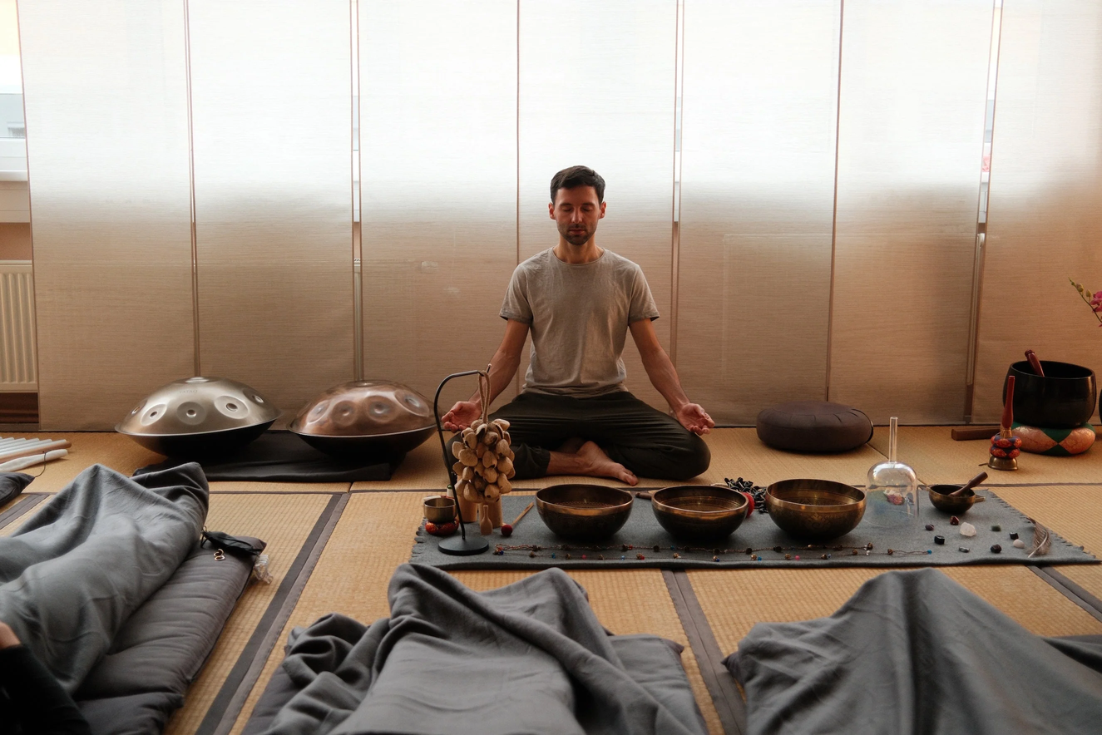
UTAR SL Yoga Club
SOUND HEALING WEEKLY CLASS
Propose new class
Propose: reduce UTAR Student stress level
.
Expected outcomes
  Sense healing: Not only sound, but smell, lightning & experiences.
  Test rate: RM 5/10 flat rate. 1st Experinces free.
  Member benifit: Member can enjoy member night, free foods, and end sem free gift etc.
AGENDA 5

Slide 13
UTAR SL Yoga Club
SOUND HEALING WEEKLY CLASS
We will share part of resource with yoga classes
New instructment need
  A high quality speaker (I have not need buy)
  梵音鼓14寸空灵鼓15音专业级初学者入门忘忧鼓碳钢舌无忧鼓乐器 - need purchase
  檀香精油凝神冥想香薰香水安睡助睡眠 - need purchase
  超声波雾化板头加湿喷雾造雾器 -need purchase
  Lighting instrument - I think i have.
  屏风 - I have also.
AGENDA 5

Slide 14
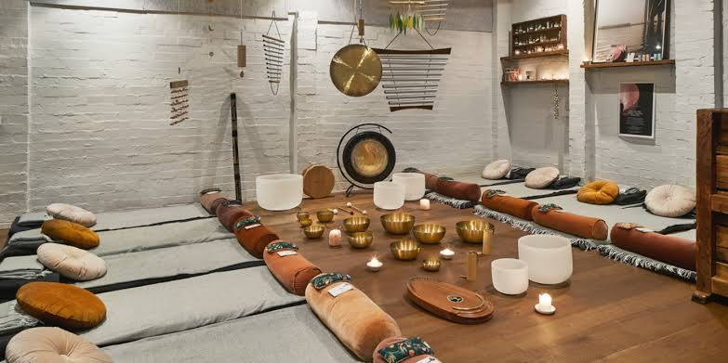
LUXURY meditation
AGENDA 5

Slide 15
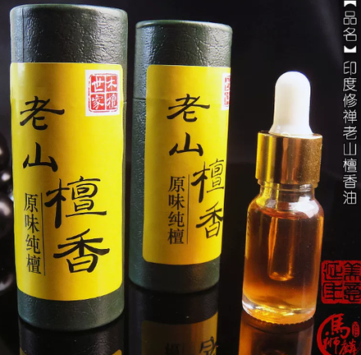
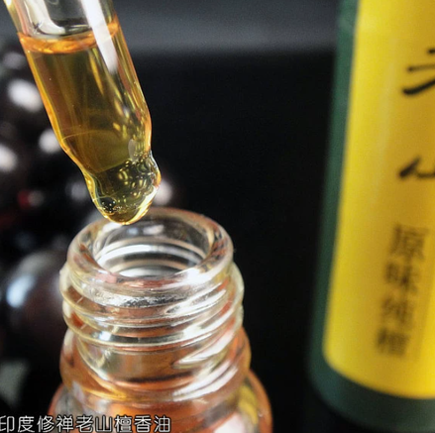


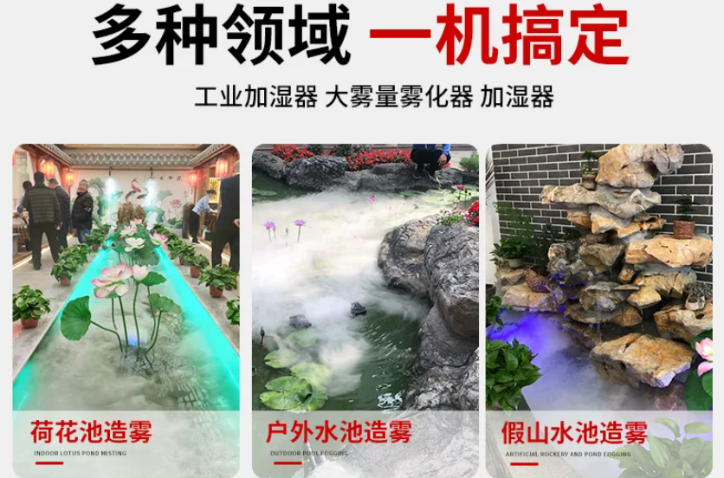
LUXURY meditation
AGENDA 5

Slide 16

UTAR SL Yoga Club
新周边 NEW MERCH
Create something special
  Lucky draw for people join
  keychain lanyard for follow our IG.
New items
  Yoga brick - 20-50 unit. (RM 6/u ✅logo)
  Yoga map - 10 unit. (RM 20/u ✅logo) (RM12/u ❌logo)
  Yoga map bag - (RM 4.6/unit ❌logo)
  Lanyard - (single color RM60/100unit, RM 300/1000 unit ✅ logo design)
  Customises key chain - (RM 71.96 one design/100 unit ✅logo design)
AGENDA 5

Slide 17
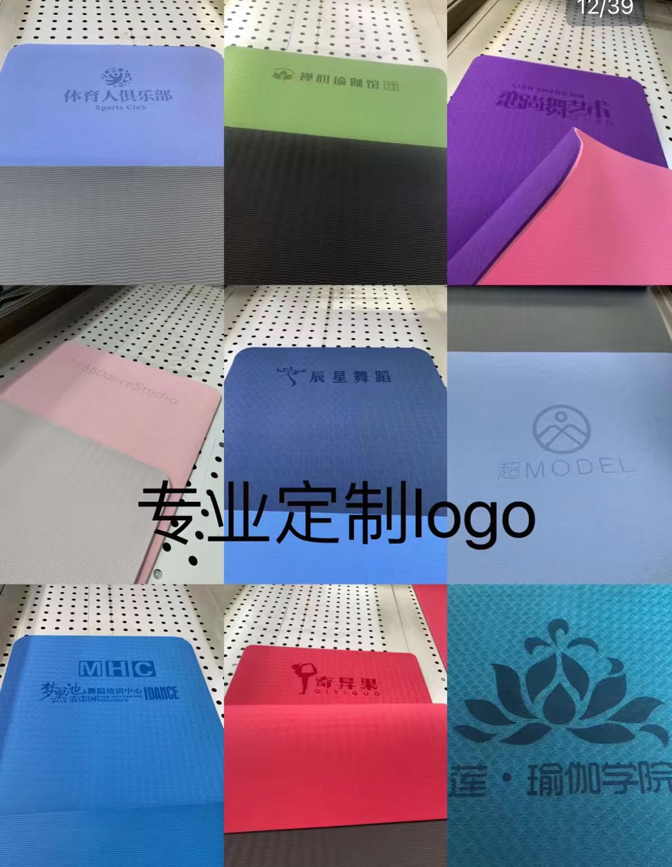
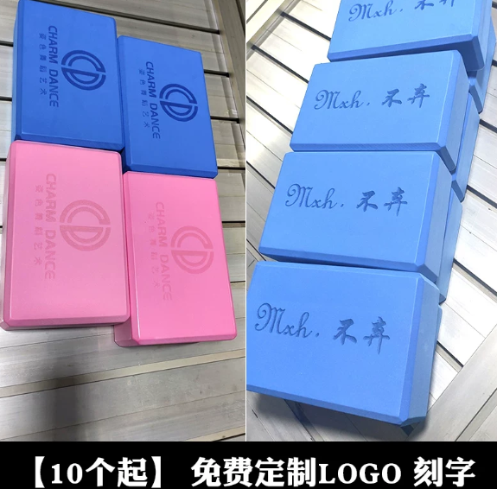
UTAR SL Yoga Club
新周边 NEW MERCH
AGENDA 5

Slide 18

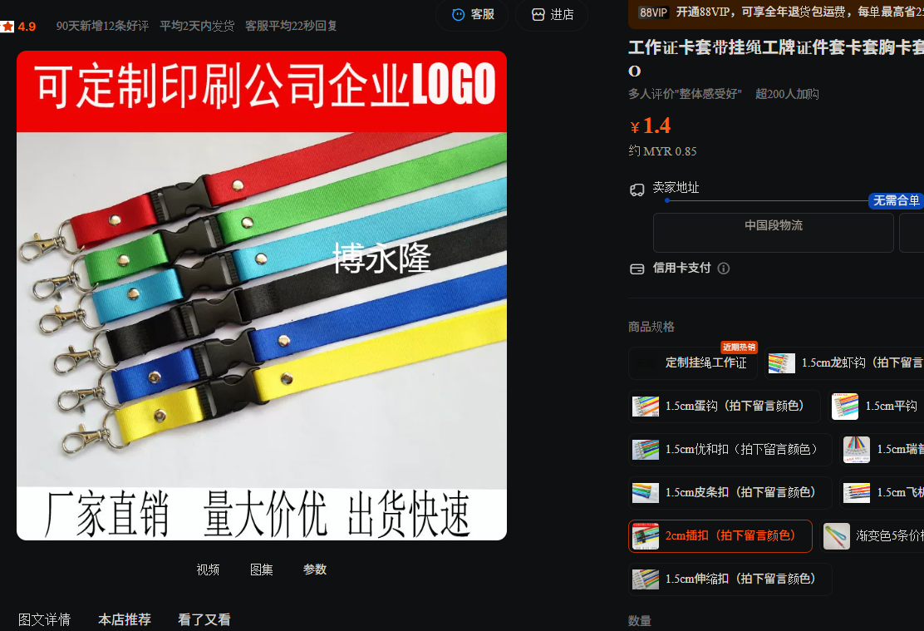
UTAR SL Yoga Club
新周边 NEW MERCH
AGENDA 5

Slide 19
UTAR SL Yoga Club
新周边 NEW MERCH
Create something special
  Lucky draw for people join
  keychain lanyard for follow our IG.
Seperate stategic
Marketing → keychain lanyard → Increase follower ( Target B2B sponsorship )
Lucky draw → (40% Key chain, 45% Landyard, 10% Yoga brick, 5% Yoga Map). Loyalty event and new member recruiting prize)
AGENDA 5

Slide 20
UTAR SL Yoga Club
WHAT IS THE FEES
Total Budget Need
Will be less than RM 1000 or around RM 1200.
For the new proposed plan.
Include all the merch and instrument.
AGENDA 5

Slide 21

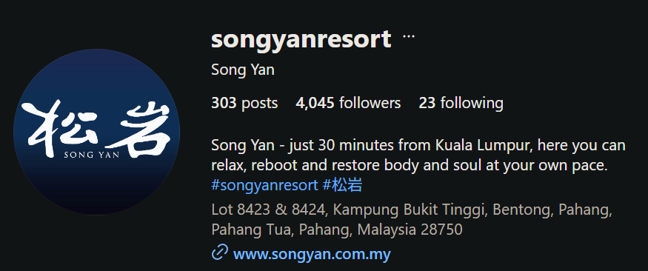
UTAR SL Yoga Club
https://www.songyan.com.my/resort
COMMITTEE TRAINING TRIP / ANNUAL DINNER
What to expect
  Fully Sponsored Food: The club is covering the meals. Just bring yourself!
  Nature Escape: A completely relaxed day trip to a green space to de-stress, get some fresh air, and bond as a team without worrying about event logistics.
  Exclusive Masterclass: We are working on bringing in a specialized master instructor for a private, committee-only outdoor yoga and meditation session.
AGENDA 5

Slide 22
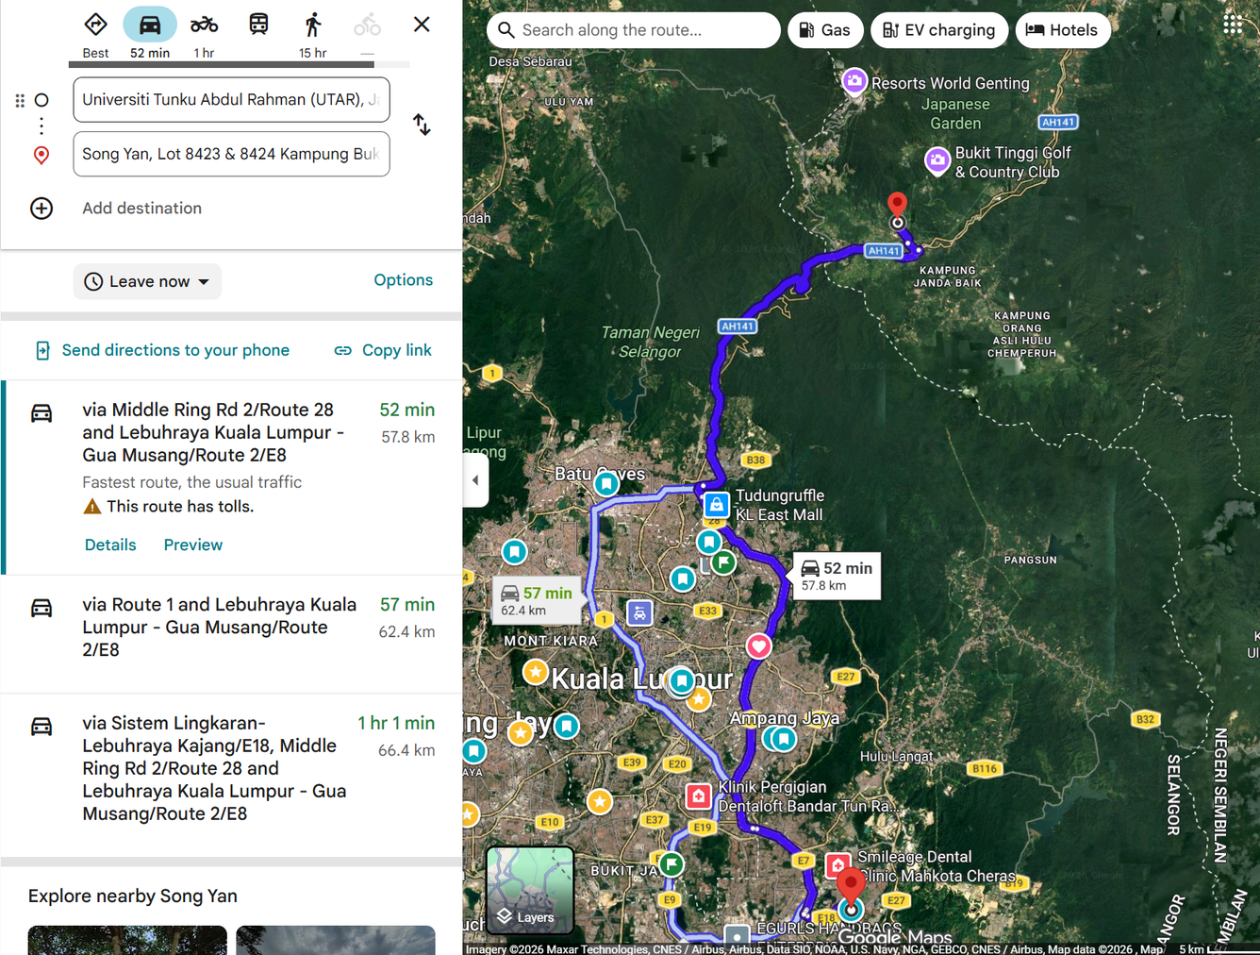
UTAR SL Yoga Club
https://www.songyan.com.my/resort
COMMITTEE TRIP / ANNUAL DINNER
AGENDA 5

Slide 23
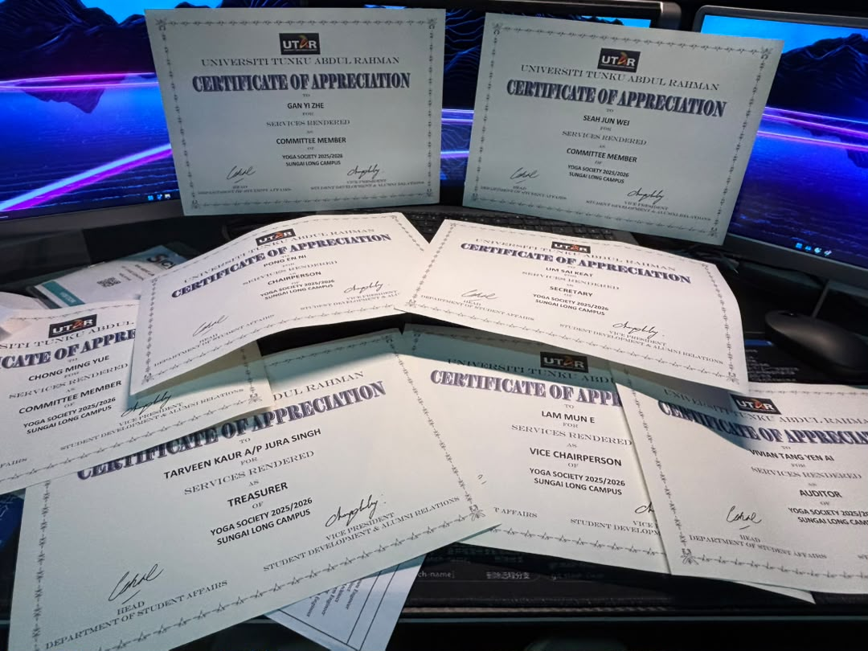
UTAR SL Yoga Club
AGENDA 5

Slide 24


UTAR SL Yoga Club
RE-POSITIONING
AGENDA 5

Slide 25


UTAR SL Yoga Club
RE-POSITIONING
AGENDA 5

Slide 26


UTAR SL Yoga Club
THANK YOU
See you on the mat soon!

Slide 27
UTAR SL Yoga Club

Slide 28
UTAR SL Yoga Club

Slide 29
UTAR SL Yoga Club
MORE ABOUT
SUSIE LIM
IG: susielim.saki
SRC & Chair of Yoga Club
AGENDA 1

Slide 30
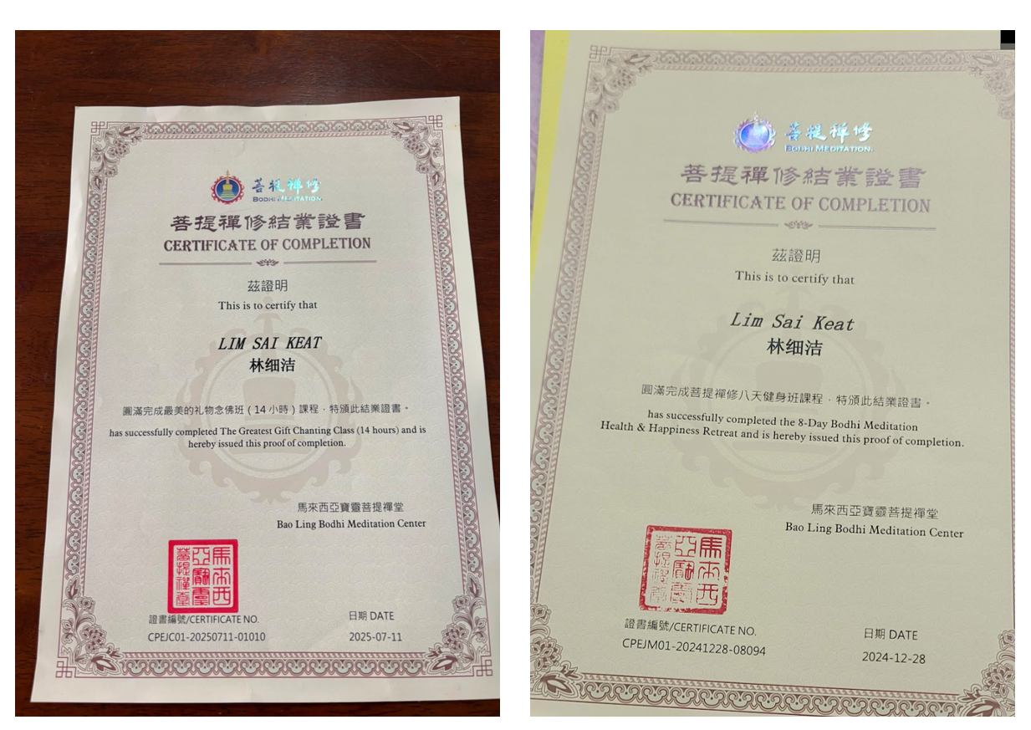
UTAR SL Yoga Club
Certificated Meditation Practitioner
AGENDA 1

Slide 31
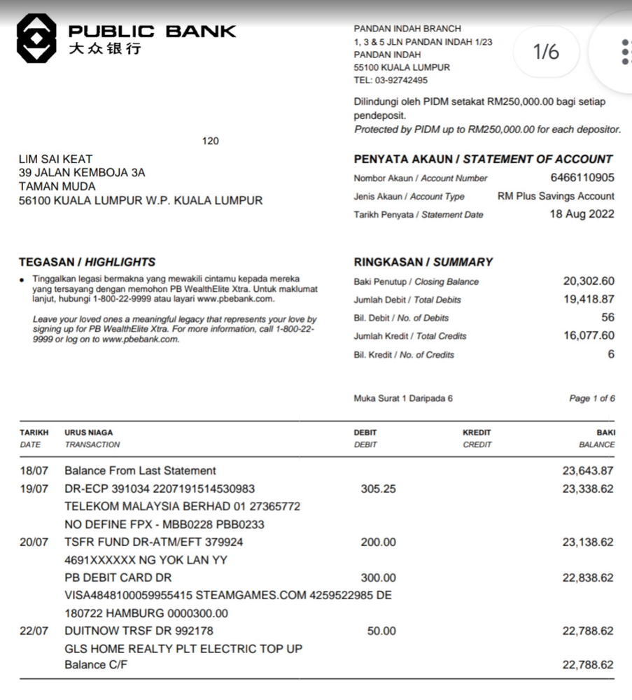
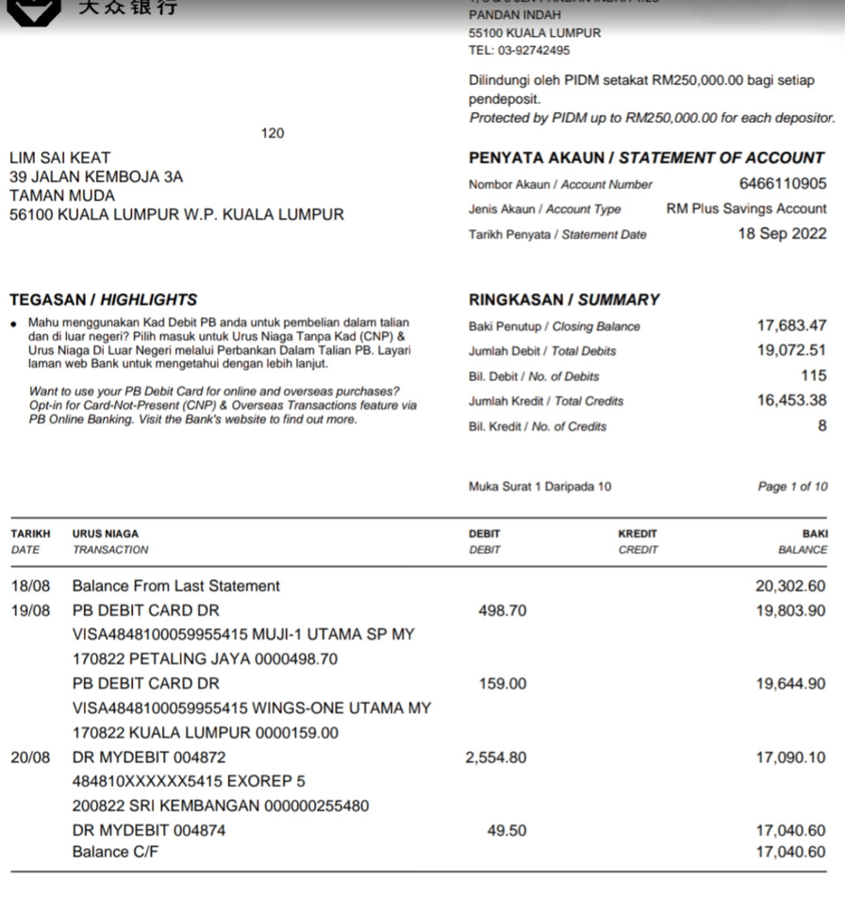
UTAR SL Yoga Club
10K monthly salary
AGENDA 1

Slide 32
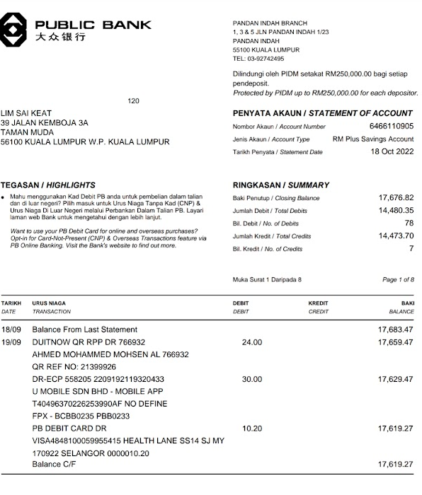
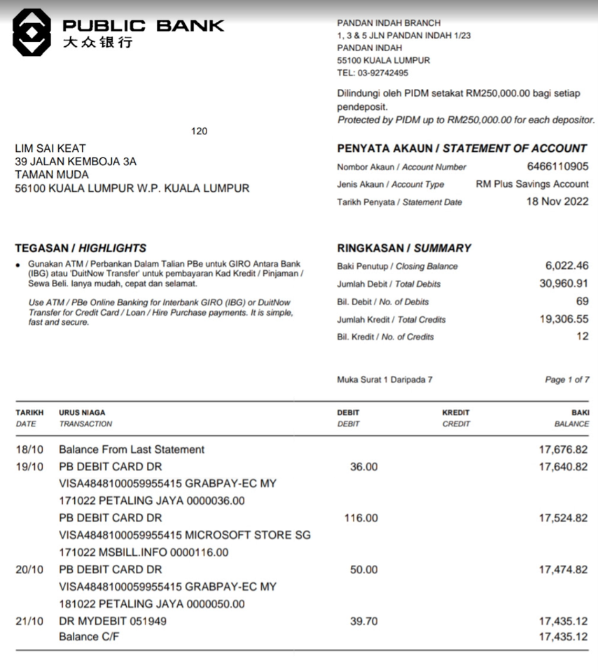
UTAR SL Yoga Club
10K monthly salary
AGENDA 1

Slide 33
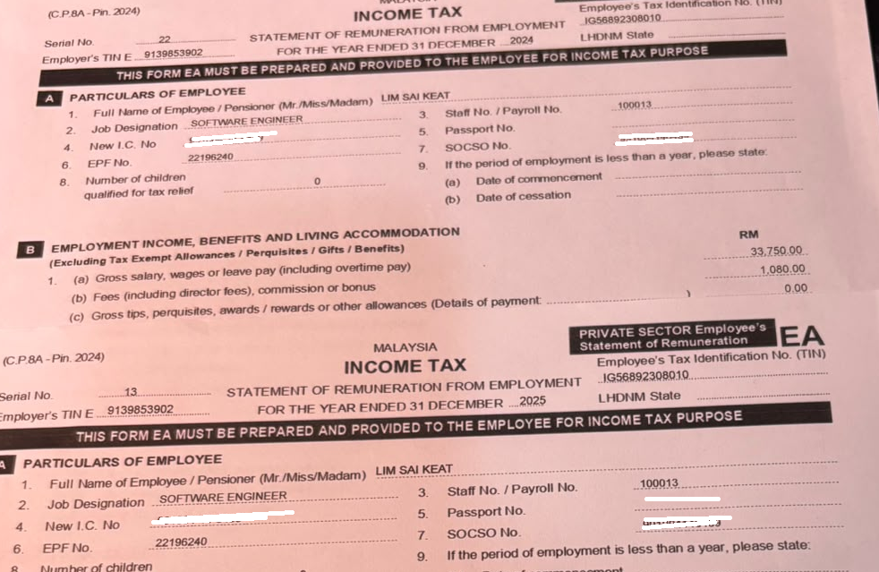
UTAR SL Yoga Club
I AM FORMAL SOFTWARE ENGINEER
AGENDA 1

